Slide 1
ADRA Licensing and Accreditation
September 18, 2018
Bangkok, Thailand
Olivier Guth

Slide 2
ADRA Worldwide Network
One Name
One Logo
One Reputation (to benefit or suffer from)
ADRA International Board responsible to control name’s use through licensing

Slide 3
ADRA Worldwide Network
Industry trends, and standards sets, for more accountability and transparency to:
Donors
Beneficiaries
Staff
Governments and general public

Slide 4
Standards
NGOs, PVOs, CSOs to meet standards:
Internal standards:
Who we are, what we do, how/why we do it
External standards
Sphere Standards, Core Humanitarian Standards (CHS), Accountable Now…

Slide 5
ADRA Licensing and Accreditation (ALA)
ALA Committee:
Advisory to Netcom
Defines criteria required for Licensing and Accreditation
Manages day to day ALA process

Slide 6
Licensing
Formal authorization given to the Church in a country, to operate an NGO using the name ADRA.
Minimum criteria, self-evaluated and endorsed by Regional/Division office.
Currently 121 licensed offices out of 130.
License given for 5 years, can be suspended

Slide 7
Licensing Minimum Criteria
Local legal registration
Established board, adoption of ADRA Purpose Statement
Local office policies and procedures, based on ADRA I Operating Policies, including HR Manual, etc. (see all ALA criteria on ENET)
Compliance with laws and regulation of the country
Established and maintained integrated Financial Management System, with adequate resources to ensure financial stability
Public liability, vehicles and property insurance in place

Slide 8
Accreditation
Accreditation is necessary, in addition to License, for ADRA Country office with:
Foreign funding
Annual activities exceeding UDS100,000.

Slide 9
Accreditation
Examples of foreign funding (including if received through a local entity):
Government agencies (USAID, DFID, etc..)
UN agencies
Embassies
Note: Private grants from ADRA offices are excluded

Slide 10
Core Humanitarian Standards (CHS)
CHS Certification
ADRA seeking certification as a network, being able to identify ADRA offices meeting the CHS Standards, as CHS certified affiliates
Certification audits carried by Hqai (Humanitarian Quality Assurance Initiative)
ALA minimum standards for certification will include the CHS standards, so all accredited offices will be CHS certified.

Slide 11
Accreditation minimum criteria (1-5)
Mission & Values
Governance & Leadership
People Management
Financial and Material Resource Management
Development Program Portfolio and Impact

Slide 12
Accreditation minimum criteria (6-10)
External Relationship. Partnerships & Networking
Corporate Identity & Marketing
Risk Management and Liability Mitigation
Safety and Security
Humanitarian Program Portfolio and Impact

Slide 13
Accreditation Minimum Criteria
10 criteria developed by 10 working groups, to be reviewed by ALA Committee on October 1, 2018
Final Criteria and ALA process launched at next IPC in February 2019
Self-evaluation for accreditation to be completed online by country offices by xxx (date), and confirmed once a year
Self-evaluations reviewed by ADRA Regional/Division office for compliance
In country visits by network experts once every 5 years.

Slide 14
Web based self-evaluation tool
Criterion 4 The agency plans and manages its financial affairs with integrity, efficiency and in a manner that ensures financial sustainability.
Country Office Reviewer: |  |  |  | External Reviewer:
Date Self Review: |  |  |  | Date External Review:
Objective 4.1: Appropriate levels of governance are in place and functioning to ensure sound financial management of the agency's operations and its long term sustainability.
OVI # | Objective Verifiable Indicator | Means of Verification |  | Compliant | Complete |  | Required for: |  | Documents Uploaded
 |  | Documentation | Interviews/ Source | Yes | Yes | No | License | Accredited
4.1.1 | Board, AdCom and Finance Sub-committee review and approve key financial reports on a regular basis, at least annually | Minutes of Board, AdCom and Finance Sub-Committee meetings | Country Director |  |  |  | Y | N
4.1.2 | Board, AdCom and Finance Sub-committee review and approve key financial reports on a regular basis, at least Quarterly | Minutes of Board, AdCom and Finance Sub-Committee meetings | Country Director |  |  |  | N | Y
4.1.2 | The Board oversees the stewardship of major asset acquisitions and disposals; long term liabilities. | Minute of Board meetings | Country Director |  |  |  | Y | Y
4.1.3 | Appropriate levels of financial scope of authority are set for Board and AdCom | Board and AdCom Terms of Reference | Country Director |  |  |  | Y | Y

Slide 15
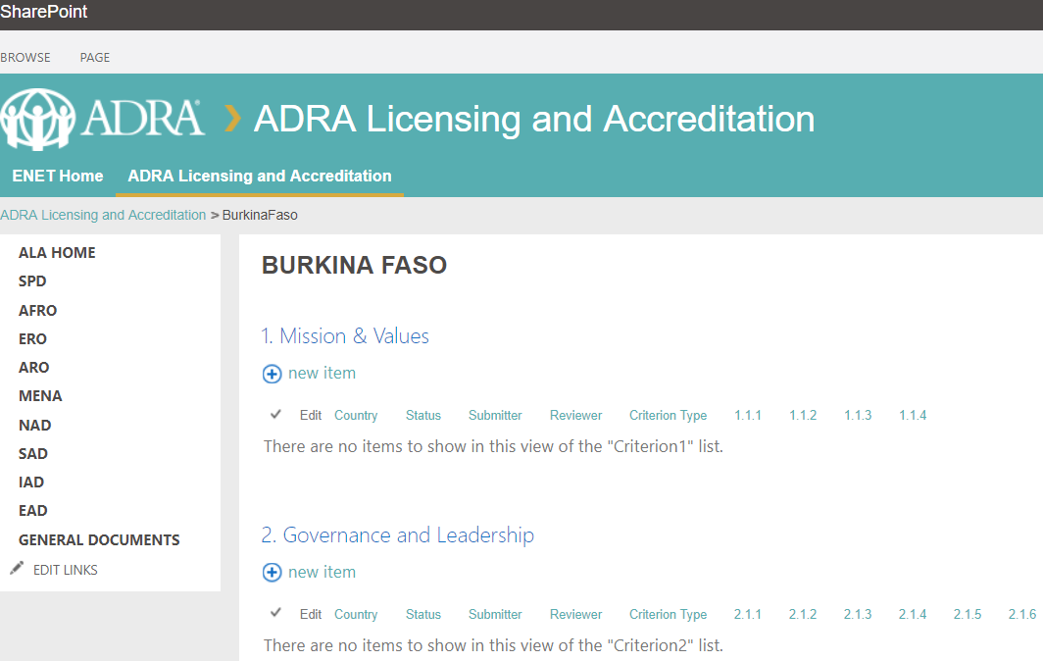
ALA self-evaluation tool (ENET in Feb 2019)

Slide 16
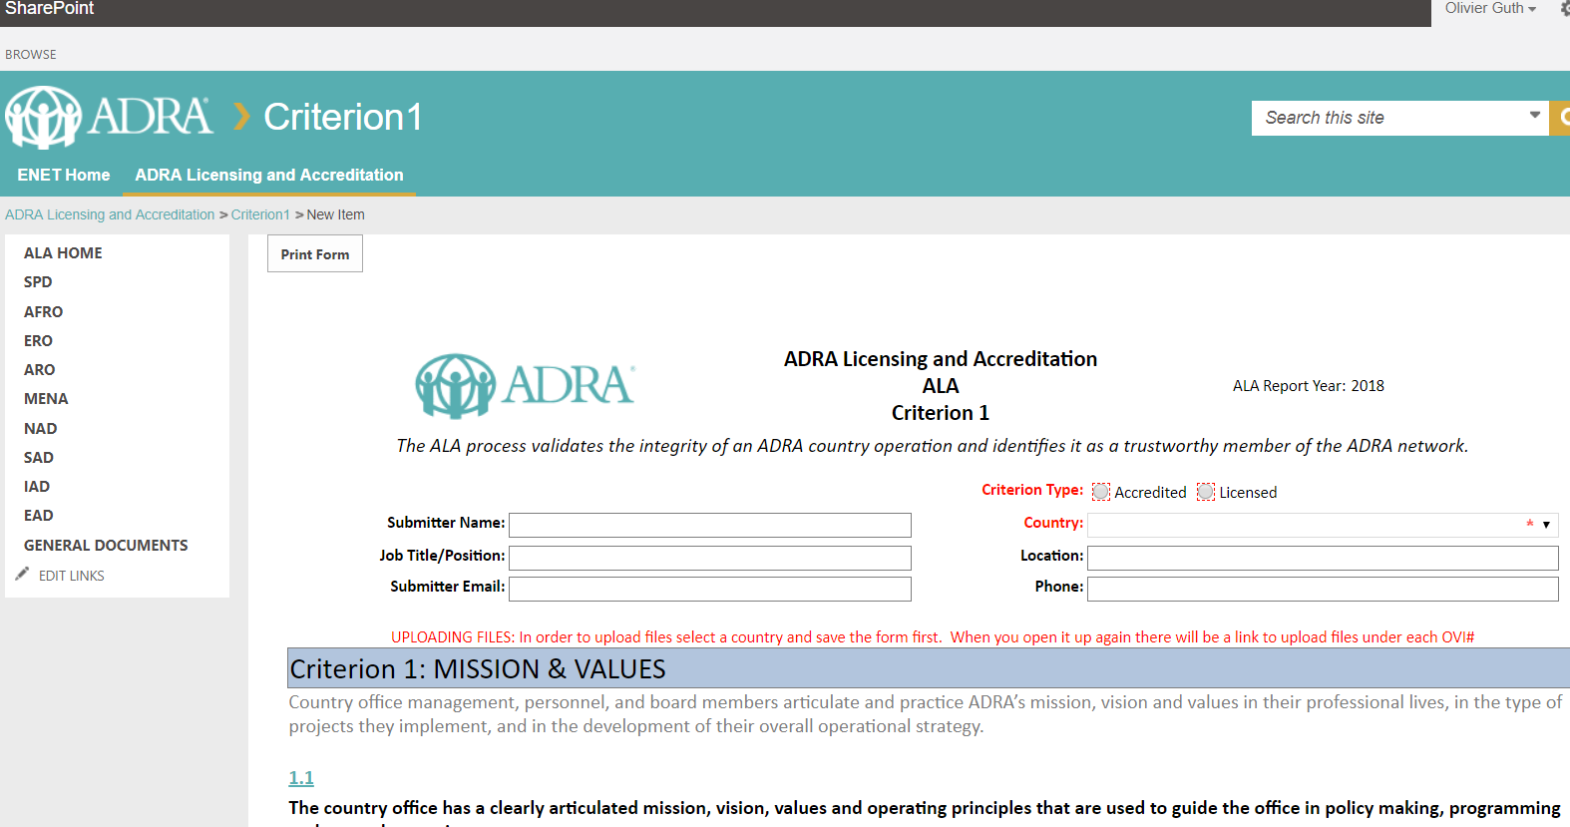
ALA self-evaluation tool (ENET in Feb 2019)

Slide 17
Thank you!

